Slide 1
TecRidge: A platform for developers to develop their technical potential and inter-personal skills.
Guide : Aparna R, Asst Prof, CSE
Team members :
1MS16cs004 - Abhishek s
1ms16cs044 – K sidhartha nambiar
1ms16cs048 – Keshava pranath k
1ms16cs052 – Lakshya sharma

Slide 2
Agenda
A platform where developers can rely for the skill development and guidance to help them shape their career.

Slide 3
Introduction
A platform for idea presentation and execution.
Platform to build skills of the developers.
Platform where ideas can meet the talent and get shaped well

Slide 4
Problem definition
Current Methodology
Journals/Research papers collection which can is shared among the paid members.
Platform that ranks the competitive coders based on their problem solving skills.
Ex: IEEE Xplore, Hackerrank .etc

Slide 5
Problem Definition
Proposed Methodology
A platform that can connect developers to shape the ideas.
Also a platform where developers can get a guide to get their idea shaped better.
Platform where a developer can know about the projects going on in the campus

Slide 6
System Requirements
For accessing the web app the browser on the user side machine must be up to date.
An uninterrupted internet connection

Slide 7
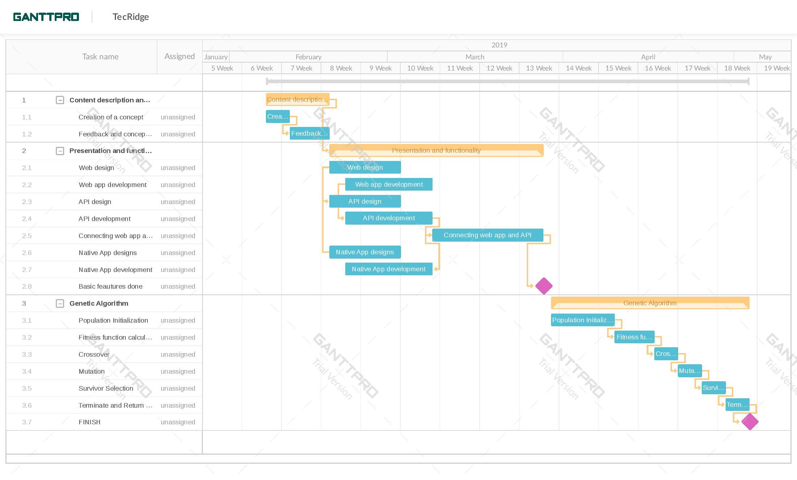
Planning
Schedule planning

Slide 8
Literature survey
For the front-end development on React-js :-
Islam Naim, Naimul. "ReactJS: An Open Source JavaScript Library for Front-end Development." (2017).

Slide 9
Literature survey
For Genetic Algorithm:-
Guo, Yonghong. "The model of weights optimization based on genetic algorithm." In 2009 International Conference on Artificial Intelligence and Computational Intelligence, vol. 1, pp. 444-448. IEEE, 2009.
Chapman, Jessica L., Lu Lu, and Christine M. Anderson-Cook. "Using Multiple Criteria Optimization and Two-Stage Genetic Algorithms to Select a Population Management Strategy with Optimized Reliability." Complexity 2018 (2018).
Konak, Abdullah, David W. Coit, and Alice E. Smith. "Multi-objective optimization using genetic algorithms: A tutorial." Reliability Engineering & System Safety 91, no. 9 (2006): 992-1007.

Slide 10
Related work
The proposed system has existing variants across the globe, the most famous one being IEEE Journal/ Research Paper collection sitehttps://www.ieee.org/which focuses on the distribution of research papers amongst paid members of IEEE.
One more variant for the idea is the platform that ranks competitive coders based on their problem solving skills, where its best example is Hackerrank website www.hackerrank.com/.

Slide 11
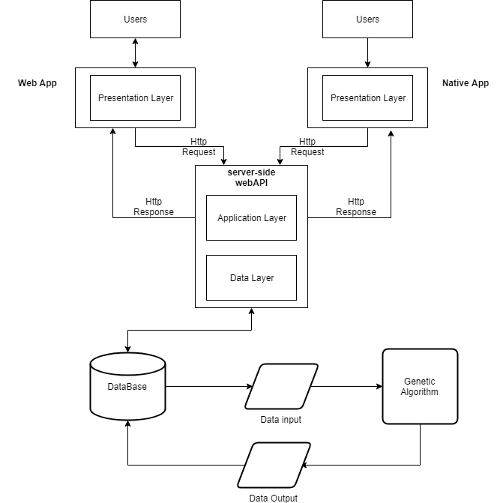
Design
System Architecture and Flowchart

Slide 12
Design
Algorithm Description
GA, is a family of algorithm that are meta-heuristic search algorithm.
GA are derived from nature’s evolution scheme and survival of fittest technique.
Click here to know more about Genetic Algorithms!

Slide 13
Design
Reason for selection of Architecture:
Because it is fast and meets the current network traffic demand.
GA has more latency than neural networks, but with each iteration population calculation becomes faster.

Slide 14
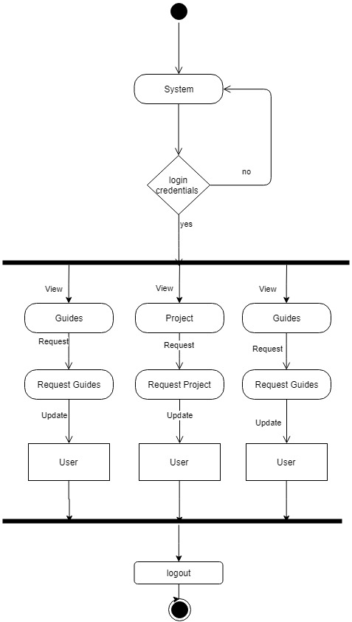
Design

Slide 15
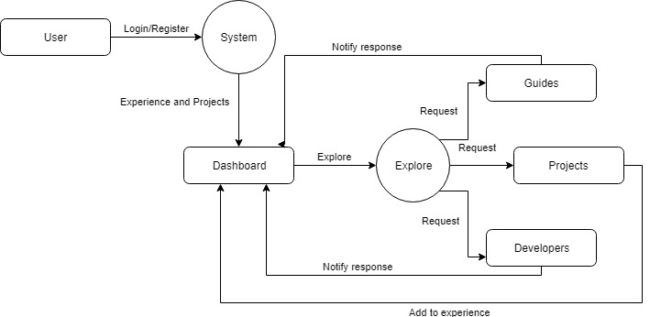
design

Slide 16
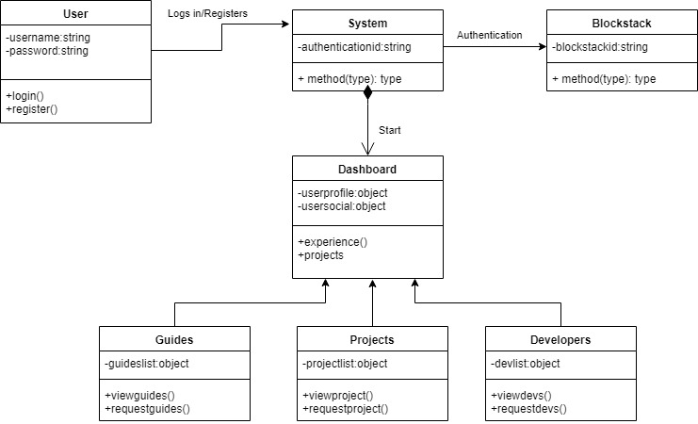
Design

Slide 17
Algorithm description
Genetic algorithms are a family of meta heuristic, search space algorithms that mimic nature's concepts of survival of the fittest, reproduction and mutation. A genetic algorithm has many parameters that distinguishes it from the other genetic algorithms; some of them are : probability of crossover, probability of mutations, crossover operator, mutation operator, termination conditions, population size, etc. The genetic algorithm we used has a probability of crossover 0.5, probability of mutation 0.01, arithmetic crossover operator with averager a = 0.4, random mutation operator and population size of 2500. The goal is to linearly combine separate, but interdependent parameters, so basically, optimize the set of weights they'll have to calculate an ELO of each project, which will help us to rank them in a just order. As of now this algorithm has 6 parameters to optimize, and room for many more.

Slide 18
Implementation details
Visual Studio Code is a streamlined code editor with support for development operations like debugging, task running, and version control.
Pycharm is a python IDE that helps developing codes and routines in python. It helps rely on the intelligent code completion, on-the-fly error checking and quick-fixes.

Slide 19
conclusion
This is a platform that provides the developers with the handy tool for dealing with the ideas they have.
This will also help developers find each other and understand the importance of team work
This will help developers to find a guide to get a correct path to design their idea in a better and efficient way

Slide 20
References
Islam Naim, Naimul. "ReactJS: An Open Source JavaScript Library for Front-end Development." (2017).
Guo, Yonghong. "The model of weights optimization based on genetic algorithm." In 2009 International Conference on Artificial Intelligence and Computational Intelligence, vol. 1, pp. 444-448. IEEE, 2009.
Chapman, Jessica L., Lu Lu, and Christine M. Anderson-Cook. "Using Multiple Criteria Optimization and Two-Stage Genetic Algorithms to Select a Population Management Strategy with Optimized Reliability." Complexity 2018 (2018).
Konak, Abdullah, David W. Coit, and Alice E. Smith. "Multi-objective optimization using genetic algorithms: A tutorial." Reliability Engineering & System Safety 91, no. 9 (2006): 992-1007.

